Slide 1
Dimensional Analysis and Similitude
Notes:
A technique for gaining insight into fluid flows before we do either extensive theoretical analysis or experimentation.

Slide 2
Outline
Nondimensionalizing the basic differential equations
Nature of dimensional analysis
Buckingham PI theorem
Significant dimensionless groups in fluid mechanics
Flow Similarity and Model Studies

Slide 3
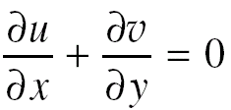
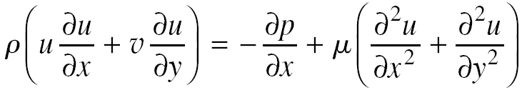
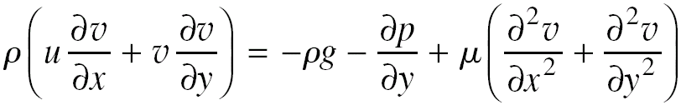
Nondimensionalizing the basic differential equations
Example – steady, incompressible, 2-D flow of a Newtonian fluid
Continuity equation
Navier – Stokes equation

Slide 4
Nondimensional quantities
Reference quantities
L → Reference length
V∞ → Reference velocity
ρV∞² → Reference pressure
Non-dimensional quantities

Slide 5
Nondimensionalizing the basic differential equations
Continuity equation (in terms of non-dimensional quantities)
N-S equations (in terms of non-dimensional quantities)

Slide 6
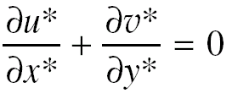
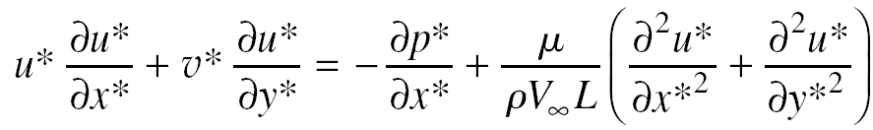
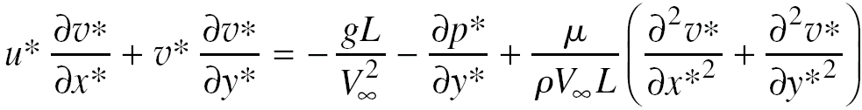
Basic equations (non-dimensional form)
Continuity equation
N-S equations

Slide 7

Nature of dimensional analysis
Example: Pressure drop per unit length
Need experimental data to find out about pressure drop along the length of the tube
So, how do we approach this problem?
Logically, it seems that we could vary one variable at a time holding the other constants.

Slide 8
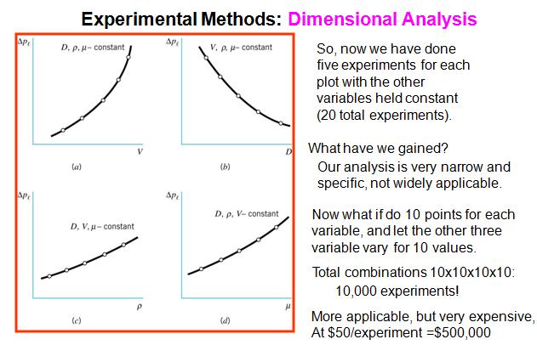
Nature of dimensional analysis

Slide 9

Nature of dimensional analysis
Example: Drag on a sphere
Drag depends on FOUR parameters: sphere size (D); speed (V); fluid density (r); fluid viscosity (m)
Difficult to know how to set up experiments to determine dependencies
Difficult to know how to present results (four graphs?)

Slide 10
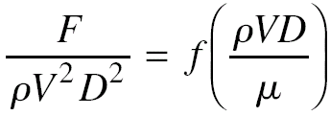
Nature of dimensional analysis
Example – Drag on a sphere
Only one dependent and one independent variable
Easy to set up experiments to determine dependency
Easy to present results (one graph) and plot is independent of the system of units used.
Now the curve is universal for any drag force on any sphere.

Slide 11
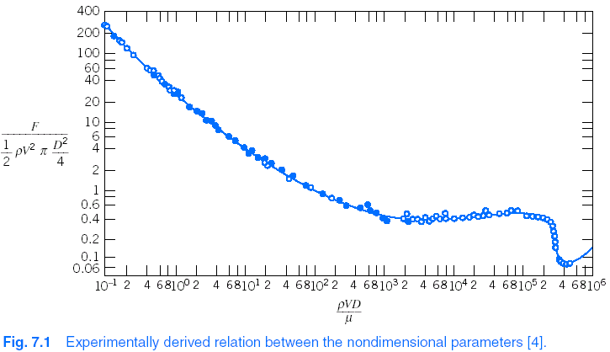
Nature of dimensional analysis – Drag force
So, how do we know what groups of dimensionless variables to form?

Slide 12
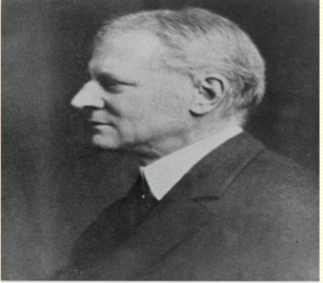
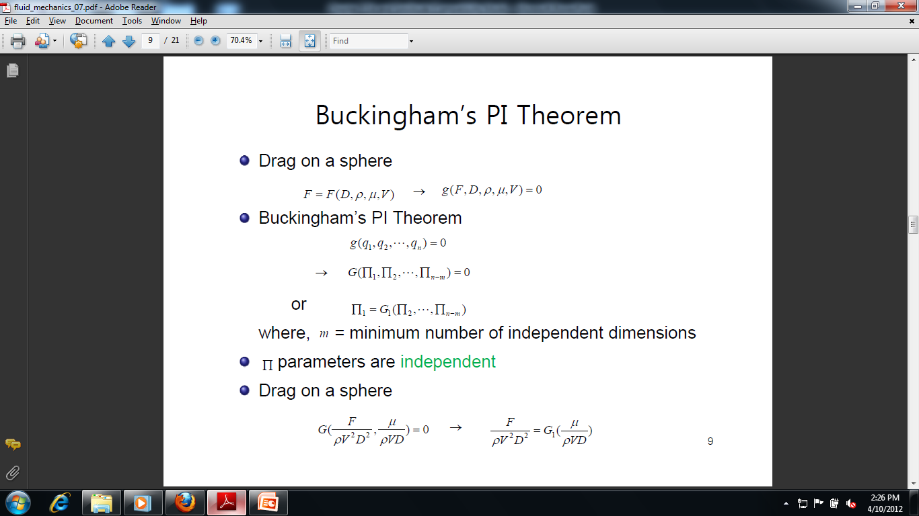
Bukingham PI theorem
Example - drag force F on sphere
The Buckingham Pi Theorem states that we can transform a relationship between n parameters of the form
into a corresponding relationship between n-m independent dimensionless parameters
Where m is the minimum number of independent dimensions required to define the dimensions of all parameters.

Slide 13
Bukingham PI theorem -
Determining dimensionless groups
Step 1
List all the dimensional parameters involved
Let n be the number of parameters
Example: For drag on a sphere, F, V, D, r, m, and n = 5
Step 2
Select a set of fundamental (primary) dimensions
For example MLt, or FLt
Example: For drag on a sphere choose MLt

Slide 14
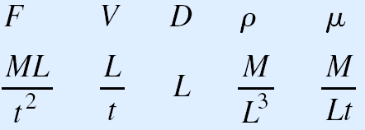
Bukingham PI theorem -
Determining dimensionless groups
Step 3
List the dimensions of all parameters in terms of primary dimensions
Let r be the number of primary dimensions
Example: For drag on a sphere r = 3

Slide 15
Bukingham PI theorem -
Determining dimensionless groups
Step 4
Select a set of r dimensional parameters that includes all the primary dimensions – repeating parameters
Example: For drag on a sphere (m = r = 3) select ρ, V, D
If a different set of repeating parameters is chosen ,different dimensionless groups will result
“No repeating parameter should have dimensions that are power of the dimensions of another repeating parameter.”

Slide 16

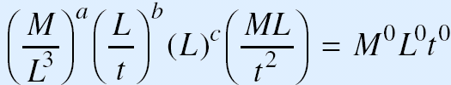
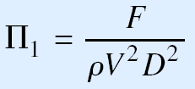
Bukingham PI theorem -
Determining dimensionless groups
Step 5
Set up dimensional equations, combining the parameters selected in Step 4 with each of the other parameters in turn, to form dimensionless groups
There will be n – m equations, where m is a rank of matrix.
Example: For drag on a sphere

Slide 17
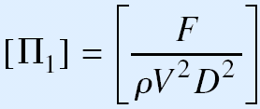
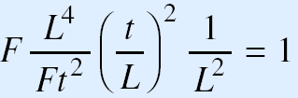
Bukingham PI theorem -
Determining dimensionless groups
Step 6
Check to see that each group obtained is dimensionless
Example: For drag on a sphere

Slide 18
Important points (Determining dimensional groups)
‘r’ = No of primary dimensions
‘m’ = fewest independent dimensions required to specify dimensions of all parameters
Value of ‘m’
m = Rank of dimensional matrix (may not be required to determine in many cases)
If m = r → Almost produces the correct no of dimensionless parameters
‘n-m’ dimensionless groups obtained are independent but are not unique.
If n-m =1 → Dimensionless group obtained must be a constant.

Slide 19
Important points (Determining dimensionless groups)
Repeating parameters
Having a choice, choose density (ρ), speed (V) and characteristic length (L) as
It leads to a set of dimensionless groups suitable for correlating a wide range of experimental data.
They are easy to measure or obtain.
Dimensionless groups obtained using these parameters always tells the relative strength of various fluid forces to inertia forces.

Slide 20
Example
Drag force on a smooth pipe
Pressure drop in pipe flow
Δp = f (ρ, V, D, l, μ, e)
Capillary effect
Δh = f (D, γ, σ)

Slide 21
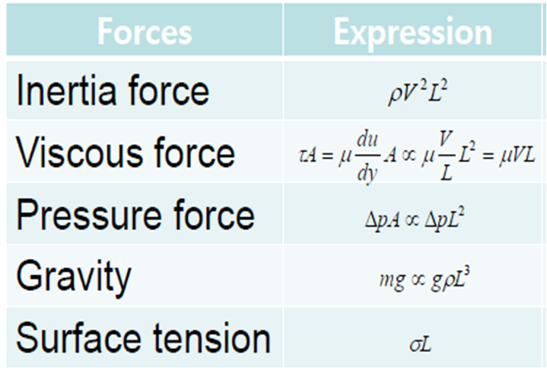
Significant dimensionless groups in fluid mechanics
Forces encountered in flowing fluid

Slide 22
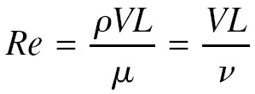
Significant dimensionless groups in fluid mechanics
Reynolds number
Ratio of inertia forces to viscous forces
First explored by Osborn Reynolds (British engineer)
Parameter → Used to determine flow regime (laminar or turbulent)

Slide 23
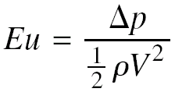
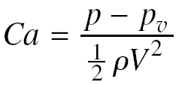
Significant dimensionless groups in fluid mechanics
Euler number
Ratio of pressure forces to inertia forces
Named after Leonhard Euler (Swiss mathematician) who first recognized the role of pressure in fluid motion
Also called as ‘pressure coefficient’
Application – Aerodynamics (where pressure or pressure difference are of importance)
Cavitation number
The smaller the cavitations number the more likely the cavitations will occur

Slide 24
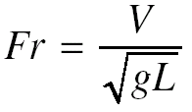
Significant dimensionless groups in fluid mechanics
Froude number
Ratio of inertia forces to gravity forces
Discovered by William Froude and his son Robert
Fr < 1 → subcritical flow and Fr > 1 → supercritical flow
Application – flows with free surface effects (open channel flows)

Slide 25
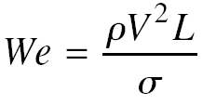
Significant dimensionless groups in fluid mechanics
Weber number
Ratio of inertia forces to surface tension forces
Important where surface tension forces are involved
It is an indicative of the existence of and frequency of capillary waves at the free surface

Slide 26

Significant dimensionless groups in fluid mechanics
Mach number
Ratio of flow speed to local sonic speed (Ratio of inertia forces to forces due to compressibility)
Key parameter in characterizing compressibility effects in a flow

Slide 27
Flow similarity and model studies
Model studies
Prototype
Full sized structure employed in the actual working condition
Model
It’s a mechanical analog of the prototype, generally a small scale replica of prototype
Objective
Test model to yield data that can be scaled to obtain relevant data for full scale prototype
It is always advantageous and preferred before undertaking any expensive engineering projects.

Slide 28


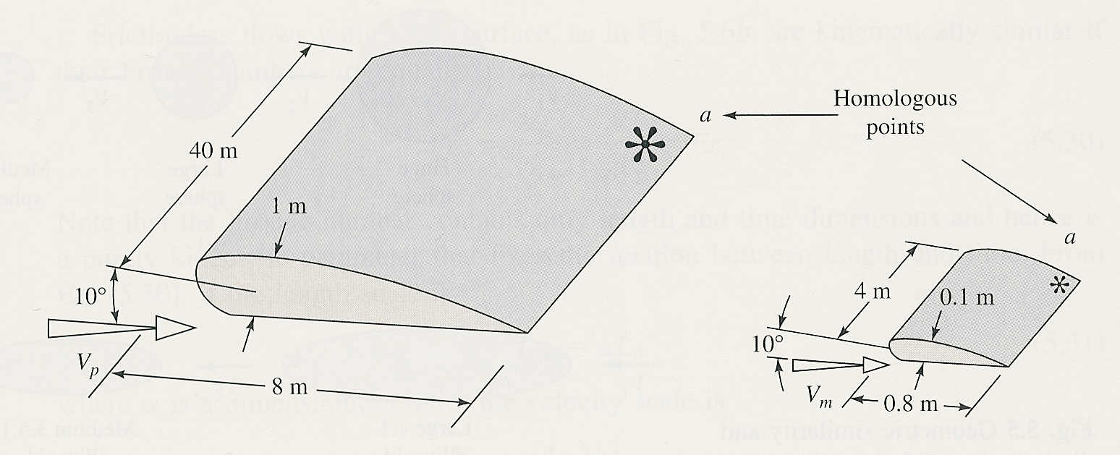
Flow similarity and model studies
Flow similarities
Geometric similarity
Model and prototype have same shape
Linear dimensions on model and prototype correspond within constant scale factor

Slide 29
Flow similarity and model studies
Kinematic similarity
Velocities at corresponding points on model and prototype differ only by a constant scale factor
(V1)_{m}/(V1)_{p} = (V2)_{m}/(V2)_{p} = V_{r}
(velocity ratio – constant scale factor)
Geometric similarity is pre-requisite for this

Slide 30
Flow similarity and model studies
Dynamic similarity
Forces on model and prototype differ only by a constant scale factor
Kinematic similarity is necessary for dynamic similarity but not sufficient condition. All forces that are important in the flow situation must be considered
To achieve dynamic similarity, we must make sure that each independent dimensionless group has the same value in model and prototype.
e.g. Re_{model} = Re_{prototype}
The actual force on the object caused by the fluid is not same for the model and prototype but dimensionless group is

Slide 31

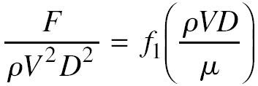
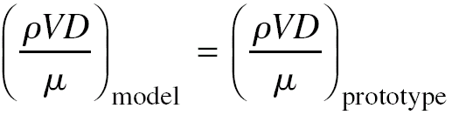
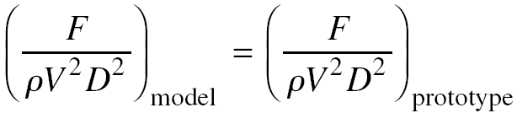
Flow similarity and model studies
Example: Drag on a sphere →
Using Buckingham Pi theorem
For dynamic similarity
then

Slide 32
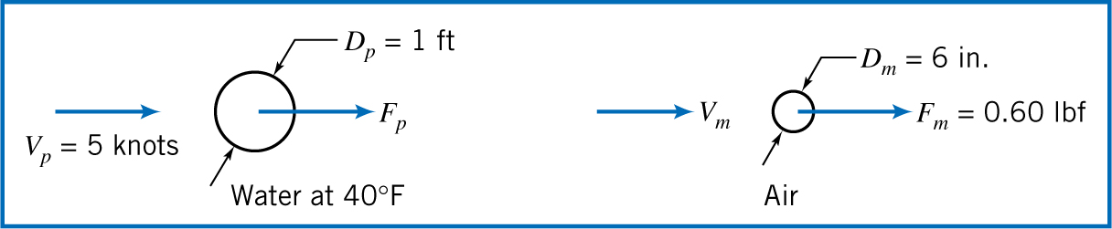
Example: Drag on a sonar transducer
Prototype –
Fluid – seawater at 4.5ºC
D = 0.3 m
V = 5 knots
Model –
Fluid – air
D = 152 mm
F = 2.7 N
Determine V_{m} and F_{p}

Slide 33
Incomplete Similarity
To achieve complete dynamic similarity, necessary to duplicate values of independent dimensionless groups.
Sometimes (e.g. aerodynamics) complete similarity cannot be obtained, but phenomena may still be successfully modelled
Drag force on a surface ship

